Slide 1

AI-Augmented Early Intervention System for Mental Health Detection on Social Media
MSc Data Science Group Project
University of Leicester
Team: Prathiksha Lakshmikanth| Harini Yerra| Rosshini Yuvaraj| Farry John Stepehsnon
Supervisor: Dr. Hammad Afzal

Slide 2

Background & Motivation
Mental health poses a significant global challenge, often exacerbated by social stigma and late diagnoses
. Traditional detection methods are often reactive, missing critical opportunities for early intervention.
Social media platforms, however, offer a unique lens into public discourse.
Social stigma and late diagnoses mean many cases go untreated until advanced stages. Social media offers real-time, unfiltered insights into emotional states.
AI-driven NLP models can analyse large volumes of online discourse, enabling early detection and potentially guiding timely interventions.
Our motivation is to leverage this rich data source to detect early warning signs for timely and effective intervention.
Notes:
To mention the seriousness of mental health issue and image to be changed // to add a news

Slide 3
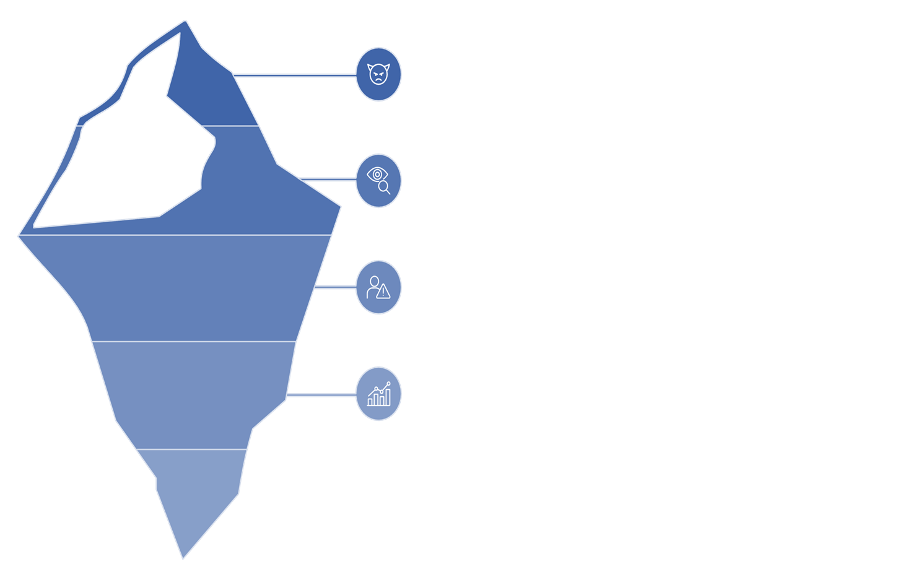




Visible Signs - The outward symptoms people exhibit, such as mood changes, distress signals, or help-seeking posts, often appear only when struggles are severe.
Surface Causes - Stressors like work pressure, financial strain, or isolation drive much of the discourse but don’t fully explain underlying conditions.
Hidden Drivers - Unseen emotional patterns and linguistic markers in online posts reveal deeper struggles that may not be openly expressed.
Deep Insights - AI and NLP can uncover these subtle cues, enabling proactive and interpretable detection of mental health risks for early intervention.
EX: "I can't stop worrying and my heart races at night"
may seem stressed, but AI detects repeated cues of anxiety and hopelessness, signaling early risk.
Notes:
To add more words and an image

Slide 4
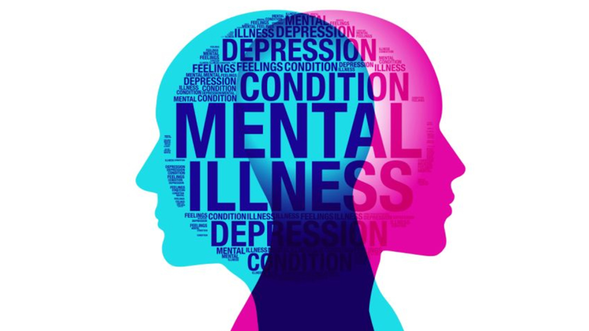
Literature Review
Previous Studies
According to the WHO Report, a person’s health is incomplete without emotional and mental health. According to an estimate, one out of five individuals in the United States suffers from some kind of mental disorder.
Studies have compared traditional machine learning with deep learning for mental health classification. Many studies used text sentiment analysis or lexicon-based features. However, these models lacked interpretability, limiting their real-world application in clinical settings.
Challenges Identified:
Semantic Overlap: Linguistic cues like "anxious" or "depressed" appear across disorders, etc.
Current Approach
We aim to contribute Improved Interpretability, Transparency, and Accuracy.

Slide 5
Problem Statement: Navigating Nuance in Mental Health Data
Semantic Overlap
Same words often span multiple disorders (e.g., "anxious" in both Anxiety and Depression contexts), complicating precise classification.
Interpretability Gap
Advanced deep learning models, while accurate, often act as "black boxes," hindering clinical trust and actionable insights.
Imbalanced Dataset
Prevalence of depression-related posts overshadows underrepresented categories like autism, creating classification bias.
Notes:
Introduce the dataset and literature review of the dataset - Conceptual Ambiguity

Slide 6
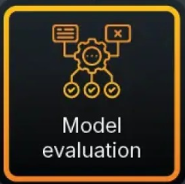
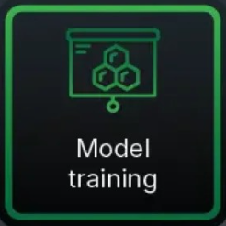
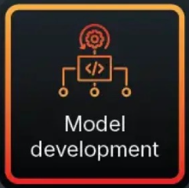
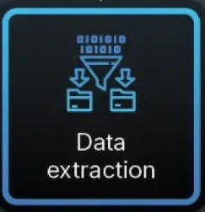
Aim and Objectives
Our aim is to build an accurate yet interpretable system for classifying mental health discourse on social media.
Data Preparation
Preprocess Reddit data & perform robust feature engineering.
Model Development
Train classical ML models & fine-tune BERT for optimal performance.
Explainability
Preprocess Reddit data & perform robust feature engineering.
Deployment
Develop an intuitive dashboard & chatbot for demonstration.
Notes:
Increase the text for Aim // change the shape of the flowchart

Slide 7




Research Questions
Classifying Mental Health
Can social media posts be accurately classified into mental health categories using interpretable machine learning models?
Linguistic Features
Which linguistic features, such as keywords and emotional tone, are most indicative of mental health disorders in social media data?
Model Comparison
How do interpretable models (Decision Trees, Rule-Fit) compare to advanced models like BERT in terms of accuracy and explainability for mental health classification?
Notes:
The first question is whether we can accurately categorize social media posts into 7 different mental health conditions, using interpretable machine learning models. The second question looks at which linguistic features, such as keywords and emotional tone, are most indicative of mental health disorders in this social media data. Finally, we'll compare the performance and explainability of interpretable models like Decision Trees and Rule-Fit, against more advanced models like BERT, to see which approaches work best for this mental health classification task. These research questions will guide our analysis and help us develop practical, explainable tools for detecting mental health issues from social media.

Slide 8


Dataset: Reddit Posts (2017 - 2018)
Source: 2017–2018 of Reddit
Key Data Challenges:
Size: Over 488,738 unique posts
Significant class imbalance across categories.
Categories: Depression, Anxiety, Bipolar, BPD (Borderline Personality Disorder), Schizophrenia, Autism, and a general "Mental-health" category.
Overlapping linguistic features between disorders.
Variability in post length (short comments vs. long narratives).

Slide 9
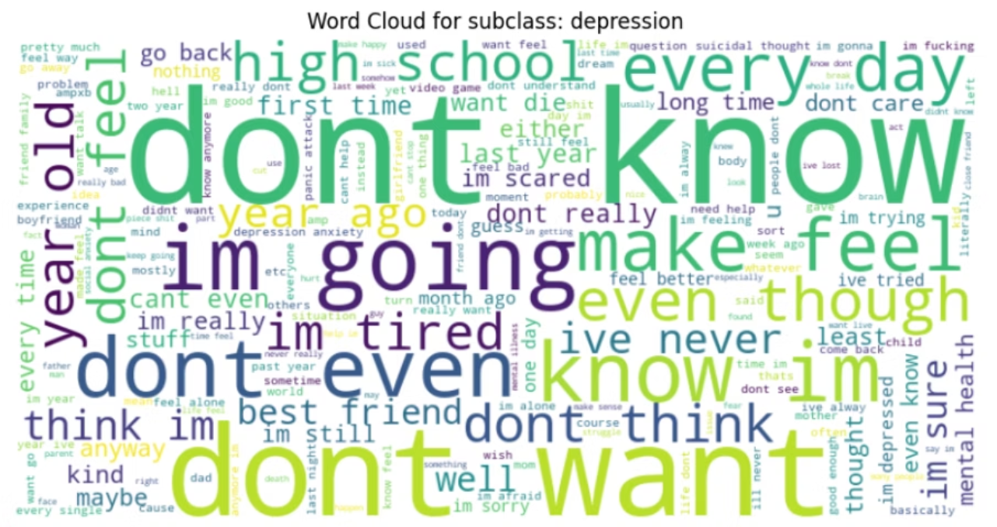
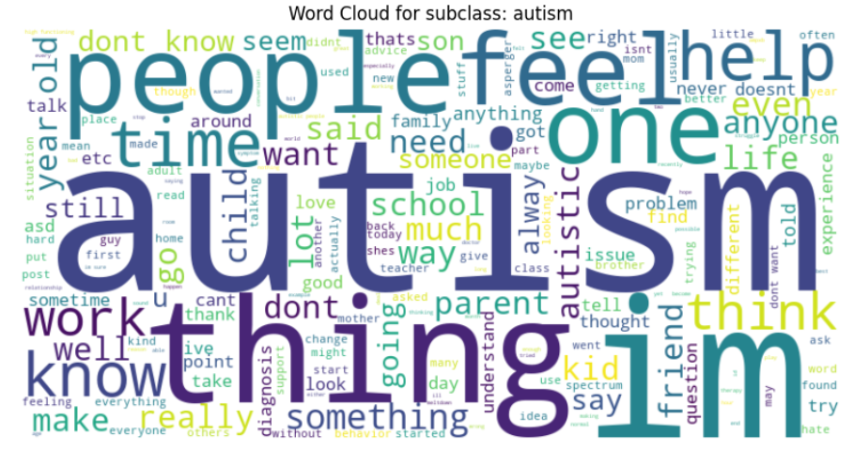
Exploratory Data Analysis (EDA)
Our EDA revealed significant class imbalance: Depression dominated with over 258,476 posts, while Autism had the smallest representation at approximately 7,142 posts.
Word cloud analysis for each category highlighted distinct, yet sometimes overlapping, thematic language:
Depression: frequently featured terms like hopeless, tired, numb.
Anxiety: revolved around panic, attack, worried.
BPD: showed words such as friend, feel, relationship.
Heatmaps confirmed the presence of shared linguistic markers across multiple disorders, reinforcing the challenge of semantic overlap.

Slide 10






Methodology Overview
Preprocessing - Combined title + text → Removed links & special characters → Normalized text → Lemmatization → Stopword removal
Feature Engineering - TF-IDF → Word2Vec → BERT Embeddings
Modelling - Traditional Models (Logistic Regression, Decision Tree, SVM, RuleFit) → Deep Learning (Fine Tuned BERT)
Evaluation - Metrics (Accuracy, Precision, Recall, F1-score) → Confusion Matrices → Binary tests → Balanced dataset with SMOTE
Interpretability - SHAP → LIME → Rulefit (human readable rules)
Deployment - Streamlit dashboard (Input (User text) → Visual output → Goal
(Supports for research))
We deployed a comprehensive pipeline, balancing predictive performance with model interpretability.

Slide 11
Data Preprocessing Pipeline
To maximize the preservation of meaningful linguistic signals while reducing noise and ensuring computational efficiency,
the dataset underwent several critical preprocessing steps.
Combining Title and Text
Concatenated for holistic analysis, as both provide
crucial cues and context.
De-identification
Removed usernames, links, and identifiers for ethical compliance and to prune irrelevant tokens.
Normalization
Lowercased text, expanded contractions, and standardized punctuation for vocabulary consistency.
Informal Writing Styles
Normalized elongated words and emojis to retain emotional cues while managing vocabulary expansion.
Lemmatization
Reduced words to their root forms using WordNet, preserving meaning and reducing redundancy.
Stopword Policy
Removed common stopwords for sparse models but retained crucial negators for semantic importance; all stopwords retained for transformer models.
Length Thresholds
Excluded extremely short posts and truncated very long ones to optimise predictive value and computational efficiency.
Notes:
Text size

Slide 12
Feature Engineering: Unlocking Textual Insights
Reddit posts were transformed into structured numerical representations using three primary approaches, each capturing different linguistic nuances.
1
2
3
TF-IDF (Term Frequency-Inverse Document Frequency)
Word2Vec Embeddings
BERT Embeddings
LIBRARY USED: GENSIM
TRANSFORMER USED: HUGGING FACE
LIBRARY USED: NLTK
Example: worried (0.82), nervous (0.80)
Example: A: “My heart is racing and I can’t breathe—think I’m having a panic attack.”
B: “I feel tightness in my chest and I’m really scared.”
C: “I aced my exam today and feel amazing!” A & B = 0.84 → very close (both describe panic symptoms)
A & C = 0.12 → unrelated (positive vs anxious)
Example: ('panic', 0.46), ('attack', 0.39)
Notes:
Machine learning models cannot directly process raw text. // one example to show all the three processing

Slide 13







Models Deployed
Logistic Regression
A baseline model, using TF-IDF. It highlights disorder-specific terms but
struggles with contextual nuances.
Decision Trees
Rule-based splits offer interpretability (e.g., "panic" suggests Anxiety),
though prone to overfitting.
Random Forest
An ensemble of decision trees provides robustness and higher
accuracy, but with reduced interpretability..
Support Vector Machine (SVM)
Maximizes class margins, performing well with embeddings that capture
semantic similarities (e.g., "worried" like "anxious").
RuleFit
Combines rules with linear terms, striking a balance between predictive
accuracy and model interpretability.
BERT
A context-aware transformer model, offering the highest accuracy
and capturing subtle meanings, but less transparent in its decisions.

Slide 14
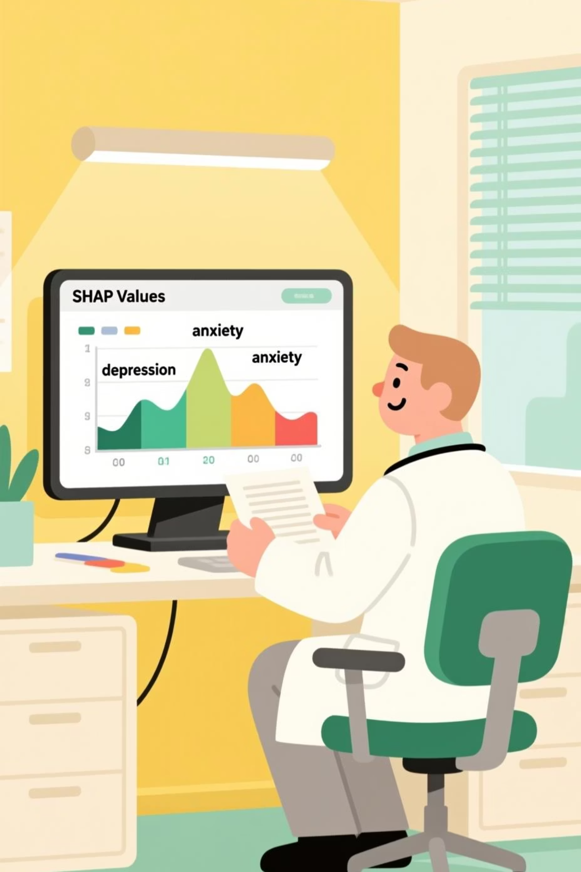
SHAP: Understanding How AI Makes Mental Health Predictions
SHAP (Shapley Additive explanations) provides critical transparency into how our models analyze text-based mental health assessments. This approach helps clinicians understand why the AI reaches specific conclusions about a patient's condition.
Key Predictive Markers
Decision Tree Patterns
We observed discrete, rule-like splits around terms like panic and bipolar, creating clear diagnostic boundaries in the model's decision-making process.
The model consistently identifies depression, depressed, anxiety, mental, and life as powerful indicators of specific conditions.

Slide 15


LIME: Providing Local Explanations for Individual Assessments
While SHAP offers global insights across the entire dataset, LIME (Local Interpretable Model-agnostic Explanations) provides crucial case-by-case transparency that clinicians need for individual patient assessments.
How LIME Complements SHAP
Identifies exactly which words in a specific patient's text drove the diagnostic prediction
Creates approximations of complex models that are interpretable at the individual case level
Allows clinicians to validate whether the model's reasoning aligns with clinical expertise
The combination of SHAP (global patterns) and LIME (individual explanations) creates a balanced interpretability framework that builds essential trust in sensitive mental health applications.
LIME highlights specific words that influenced the model's prediction for an
individual case

Slide 16
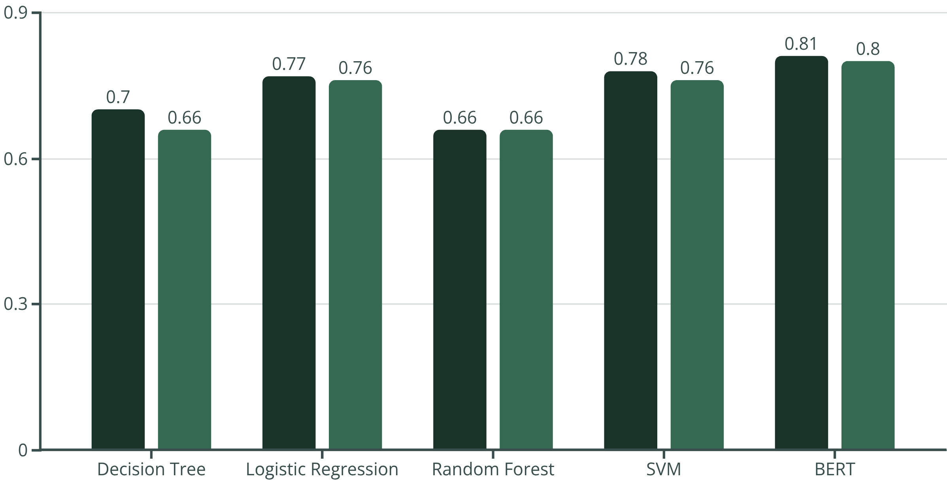
Model Performance
The fine-tuned BERT model consistently outperformed classical models, demonstrating the power of contextual embeddings.
Accuracy
Weighted F1-score
BERT achieved the best performance, but all models struggled with the umbrella 'mental-health' category due to semantic overlap.
Notes:
To be added before BERT

Slide 17
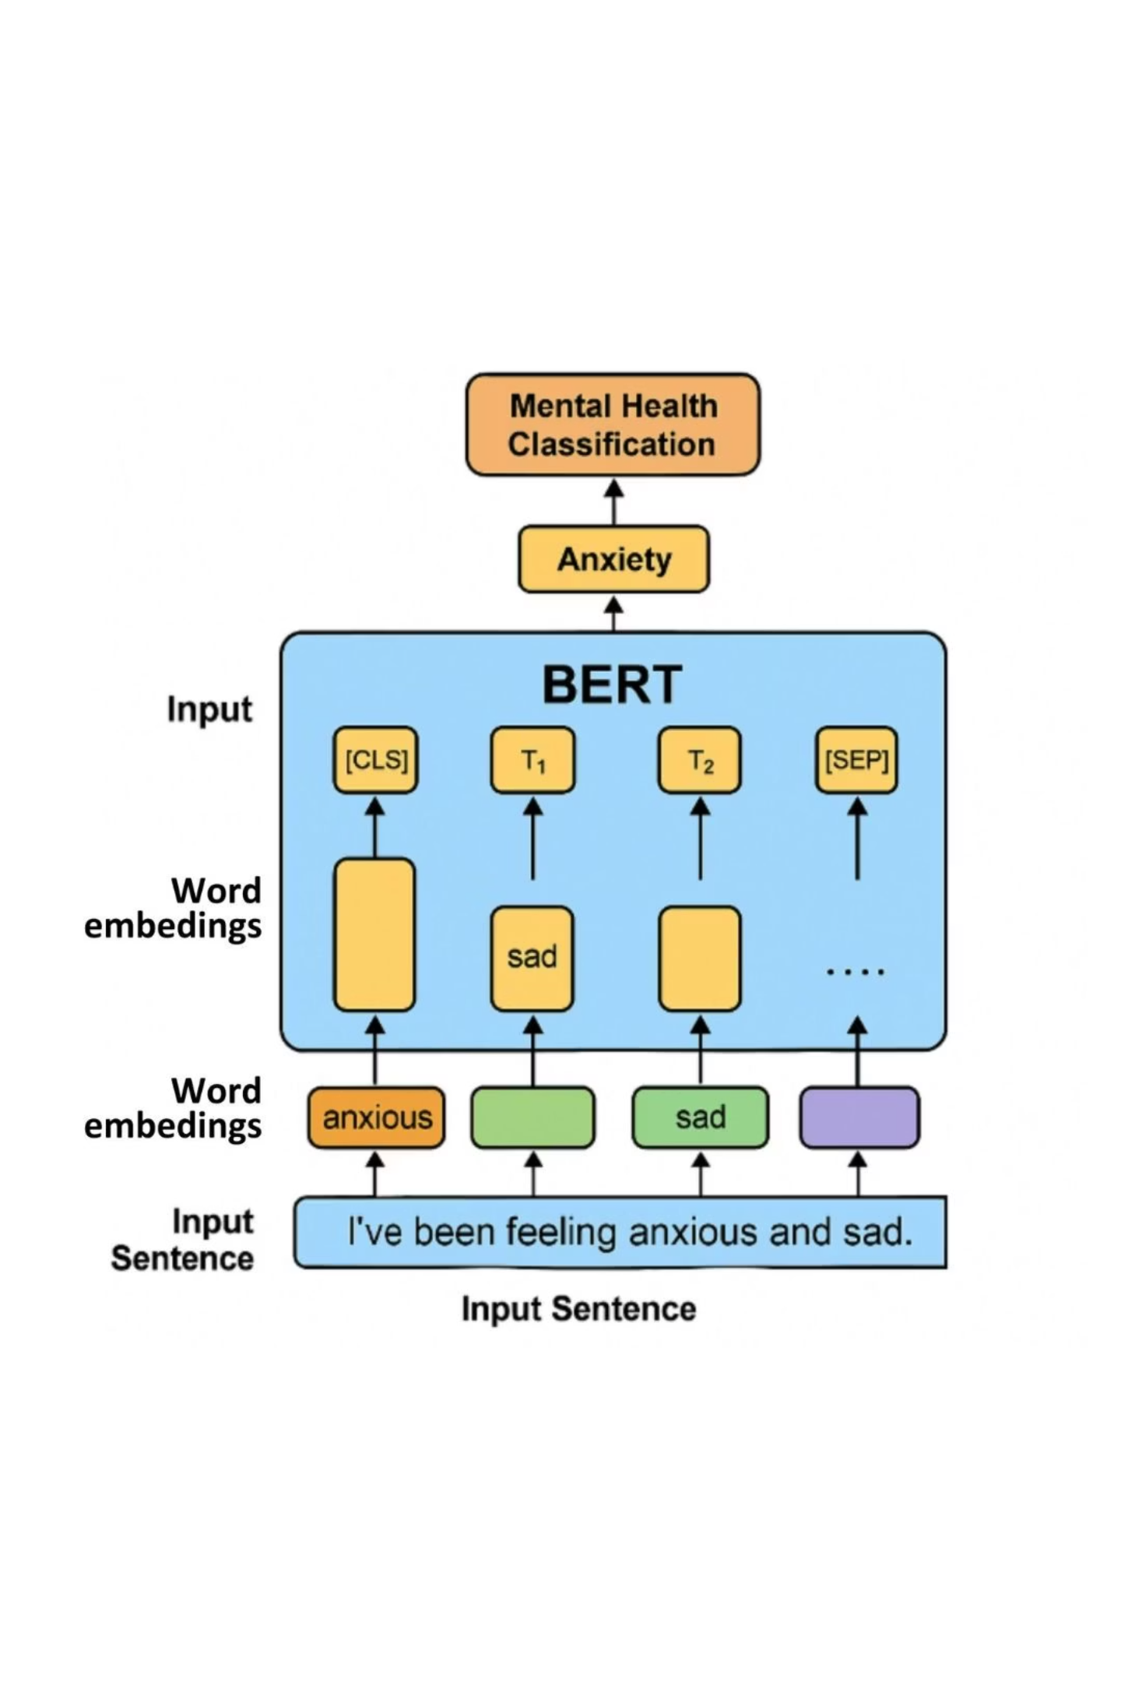
BERT: State-of-the-Art
The fine-tuned BERT model significantly outperforms all classical models in accuracy and F1 score, demonstrating its strength in capturing subtle linguistic patterns and providing clinically meaningful explanations.
1. Superior Accuracy
Achieved 80.64% accuracy and 0.797 weighted F1-score, a significant improvement over Logistic Regression (69-70%) and Decision Trees (66-70%).
2. Consistent Performance
High recall for Depression (0.9296) and balanced performance for Anxiety (F1=0.8088), effectively capturing indirect expressions.
3. Explainability
LIME and SHAP highlight disorder-specific tokens, providing clinically meaningful explanations crucial for trust in healthcare contexts.

Slide 18
BERT explained with SHAP
SHAP
String influence of words: anxiety, safe, medication, extreme, benzo
Shows feature contributions shifting prediction from base value
Provides global consistency in explanations.
Notes:
To be added before BERT

Slide 19
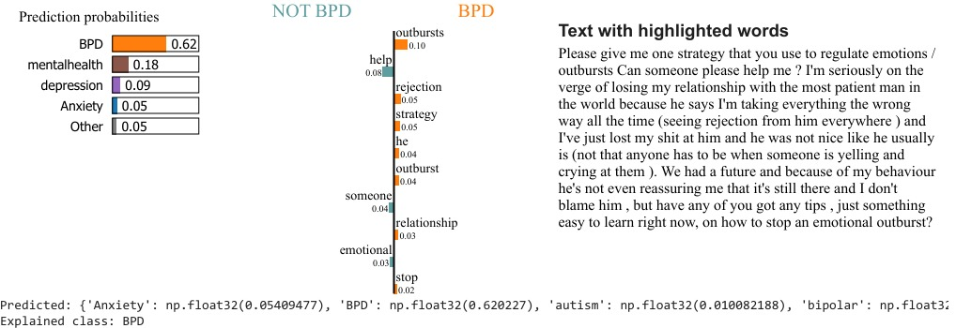
BERT explained with LIME
LIME
Predicted class: BPD (62%)
Key contributing words: outbursts, rejection, relationship, emotional
Explains local word importance for the given text.
Notes:
To be added before BERT

Slide 20

Anger
Negativity
Joy
Trust
Sadness
Positivity
Trust
Decoding Emotions
Exploring the emotional landscape of mental health through computational psycholinguistics.
Applying the NRC Emotion Lexicon
The NRC Emotion Lexicon, a powerful tool for sentiment analysis, was applied to examine seven mental health-related subreddits. This lexicon assigns sentiment and emotion scores (anger, fear, sadness, joy, trust, etc.) to words, enabling us to quantify the emotional content of vast amounts of text data.
Notes:
One more slide about the NRClex and the real-time example

Slide 21
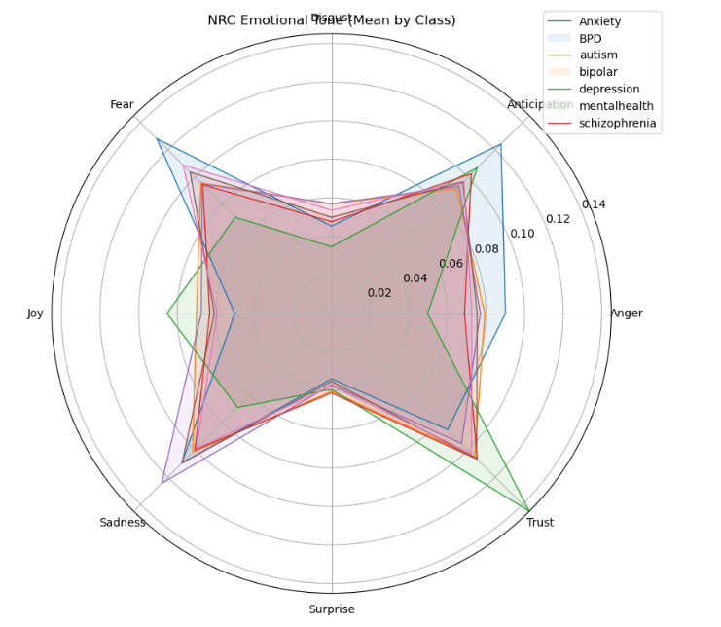
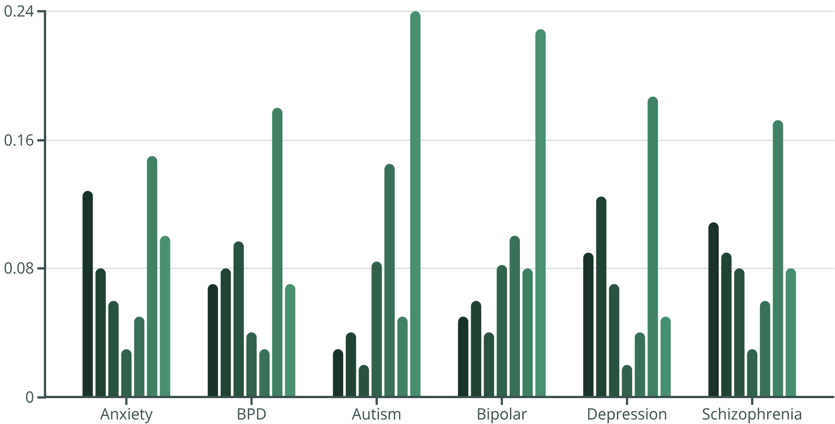
Visualizing Emotion
The Emotional Landscape
The chart visualizes the emotional "fingerprints" of each condition.
Fear
Sadness
Anger
Joy
Trust
Negativity
Positivity
Anxiety spiked on fear, BPD on anger, and depression on sadness. In contrast, Autism and Bipolar displayed stronger positivity
and trust. Schizophrenia was characterised by fear and negativity.
Notes:
Change the colour

Slide 22
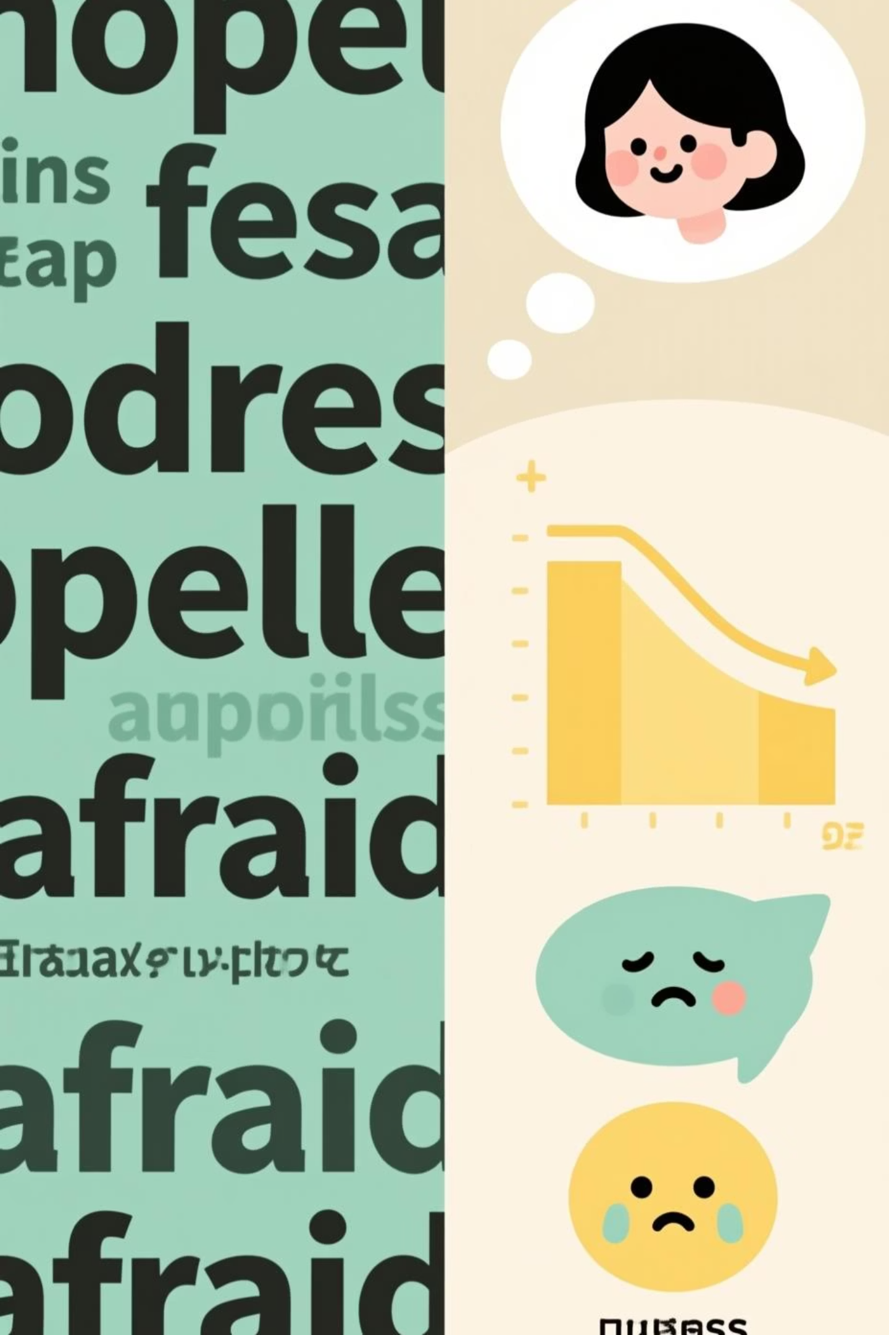
Individual Post Analysis
Capturing Nuance in Personal Narratives
The lexicon also provides granular insights into individual posts. For instance, in the post:
"I feel hopeless and afraid, but talking to friends helps a bit."
The detected emotions were primarily fear (0.667) and sadness (0.333). This precisely aligns with human interpretation, where feelings of hopelessness and fear dominate, while social support offers a slight mitigating influence.
Notes:
Last line as points

Slide 23



Unveiling Latent Themes: Topic Modeling in Mental Health Forums
We employed Latent Dirichlet Allocation (LDA) to uncover the hidden thematic structures within a preprocessed Reddit mental health dataset. This method helps us understand the natural clusters of language used by individuals discussing their experiences.
Reddit Dataset
Latent Structures
LDA Application
Analyzing real-world mental health discussions.
Utilizing a robust topic modeling framework.
Identifying hidden thematic patterns.

Slide 24
Decoding the Discourse: Key Topics and Their Salient Terms
Topic 1: Emotional Struggles
Topic 2: Daily Cycles & Fatigue
Topic 3: Interpersonal Conflict
don't, feel, like, know, want, can't
day, sleep, time, night, feeling
friend, said, told, back, didn't
Topic 4: Functional Stress
Topic 5: Diagnosis & Treatment
Topic 6: General Symptom Experiences
job, work, school, year, going
bipolar, medication, schizophrenia, diagnosed, symptom
I've, get, feeling, help, med
Topic 7: Psychotic Experiences
voice, delusion, thought, mind, schizophrenia
View Interactive LDA Visualization

Slide 25
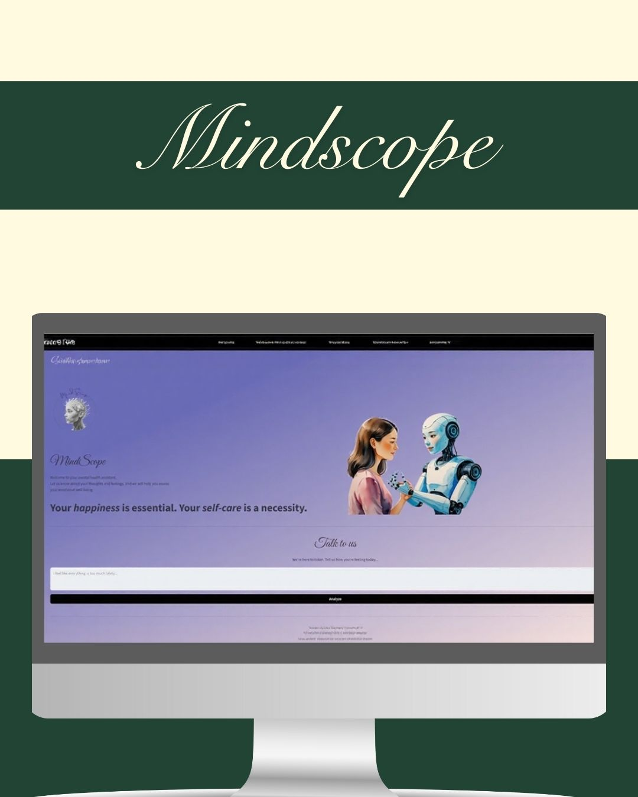
Bridging NLP Research with Interactive Application
The deployed system functions as a proof-of-concept, showcasing how NLP can be embedded into user-facing applications.
Allows users to enter text about their feelings and instantly receive classification feedback.
Feedback includes probability distributions and confidence scores.
Technology Stack: Powering the Prototype
Streamlit
PyTorch
Hugging Face
Plotly Express
Notes:
Reduce the text // highlight

Slide 26
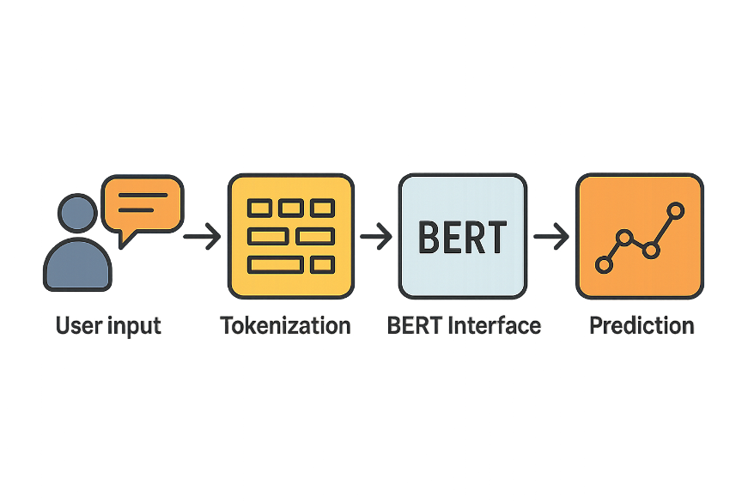
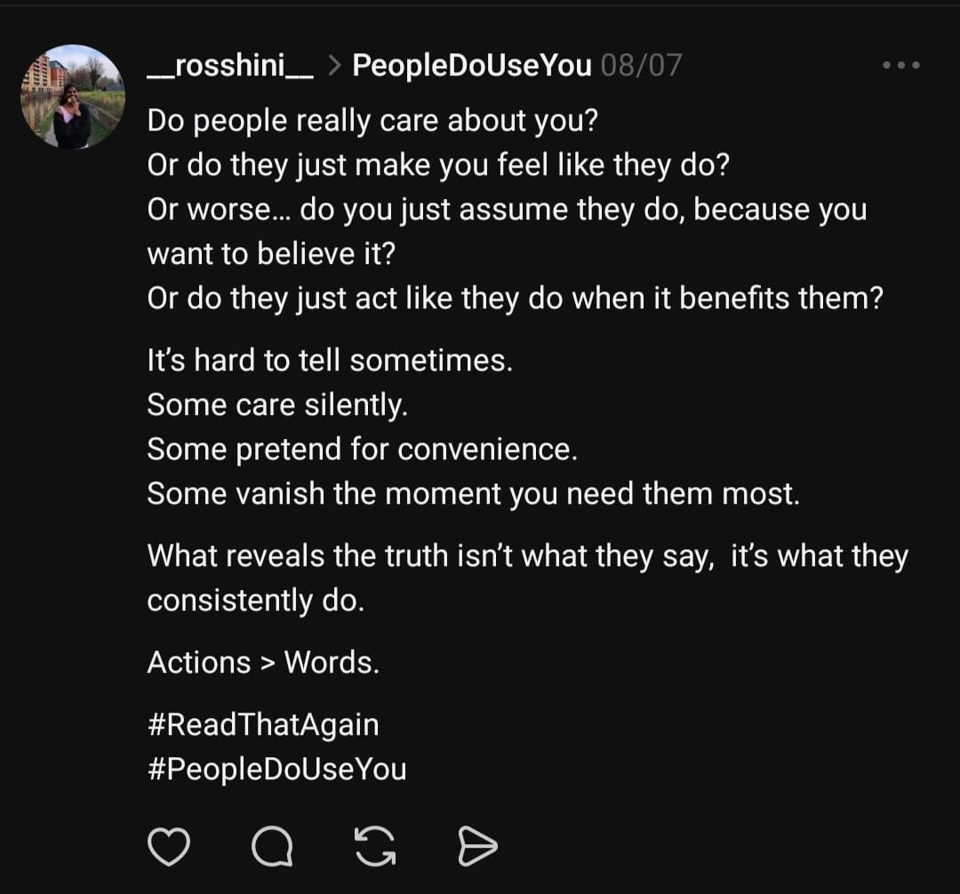


System Workflow: From Text to Insight
User enters text
It evaluates the input across different possible mental health categories and gives the prediction and confidence score.
Text broken down into smaller units (tokens)
It prepares the sentence for BERT by converting words into numerical form.
BERT processes tokens using deep contextual understanding of language.
The model outputs the most likely classification.

Slide 27
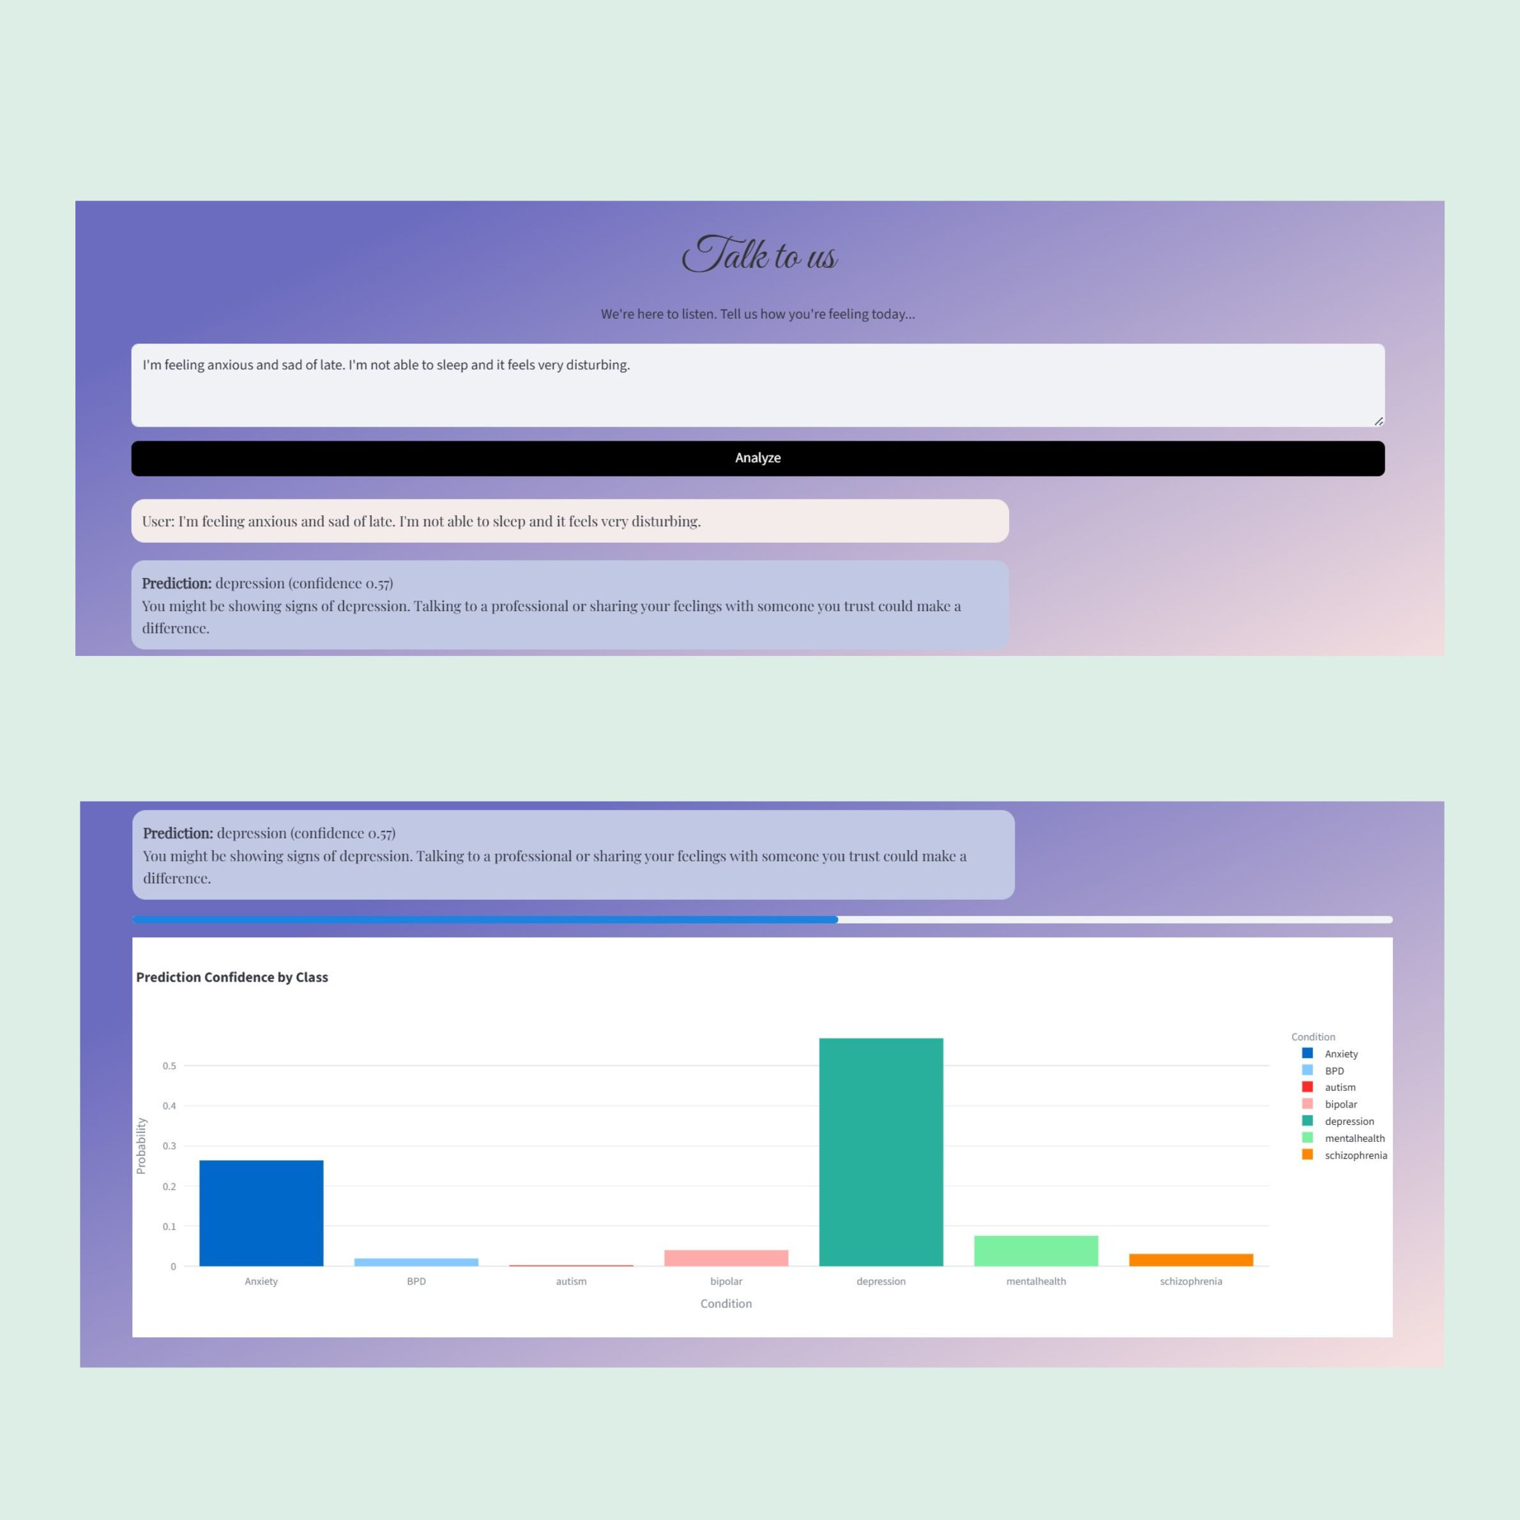
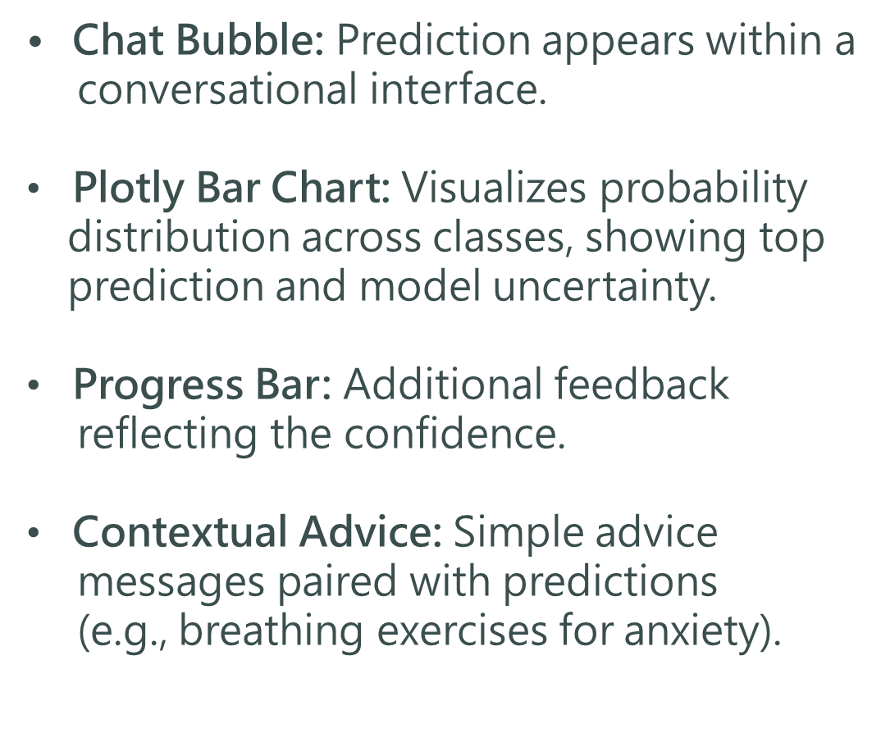
Output Visualization: Clarity and Context
"TEST YOUR MENTAL HEALTH"
Notes:
Own graph

Slide 28




Achieving Outcomes: A Collaborative Approach
Our structured approach and collaborative spirit consistently lead to exceptional project outcomes, characterized by technical excellence and practical utility.
Timely Completion
Balanced Workload
Although there were slight delays, the project components were delivered on schedule, meeting critical deadlines.
Workload distribution optimized across the team, preventing burnout and maximizing productivity.
Technically Robust
Practically Useful
The final system demonstrates high technical integrity, performance, and scalability.
The solution directly addresses user needs and provides meaningful, actionable insights.
This integrated approach ensures that the final machine learning system is not only technically sound but also
delivers tangible value.

Slide 29

Data Challenges & Linguistic Nuances
Large but imbalanced corpus → Depression overrepresented, Autism underrepresented.
Informal/noisy language → slang, emojis, elongated words.
Short vs. long posts → preprocessing needed (filtering, truncation).
Context-dependent meanings → e.g., mad (angry vs. mentally unwell), panic (attack vs. buying).
Disorder-specific cues exist but overlap with general mental health language → label ambiguity.
Notes:
points

Slide 30
Future Work
Expanding Data & Refining Models
Data Refinement
Model Innovation
Revisit umbrella categories with clinical experts; expand to multilingual or multi-platform data, including longitudinal studies.
Can add LDA to it along with BERT, and hybrid interpretable architectures with newer LLMs. Incorporate multimodal data.
These avenues aim to enhance reliability, generalizability, and predictive power.
Scalability & Ethical Considerations
Scalable Deployment
Ethical, Fairness, & Policy
Containerization, API integration, and real-time monitoring for robust, practical systems.
Conduct fairness audits to mitigate bias. Engage ethicists, clinicians, and lived-experience individuals.
Future work must prioritize ethical safeguards and user-centered design for responsible AI adoption.

Slide 31

Conclusion & Reflection
Performance & Interpretability Must Coexist
This project demonstrates AI's promise in mental health research while stressing that technical innovation must align with human-centered design and ethical reflection.
By balancing performance with interpretability, fairness, and ethical safeguards, we can develop tools that genuinely support individuals, clinicians, and communities.
Notes:
Risks and challenges &

